Slide 1
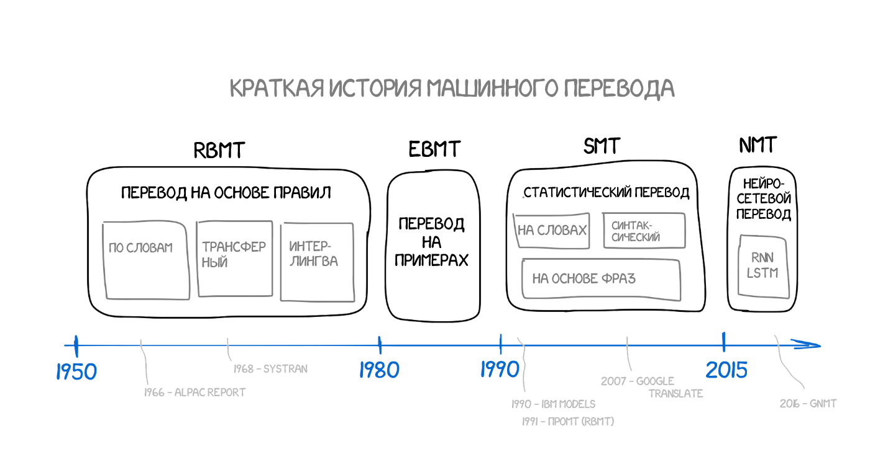

Slide 2
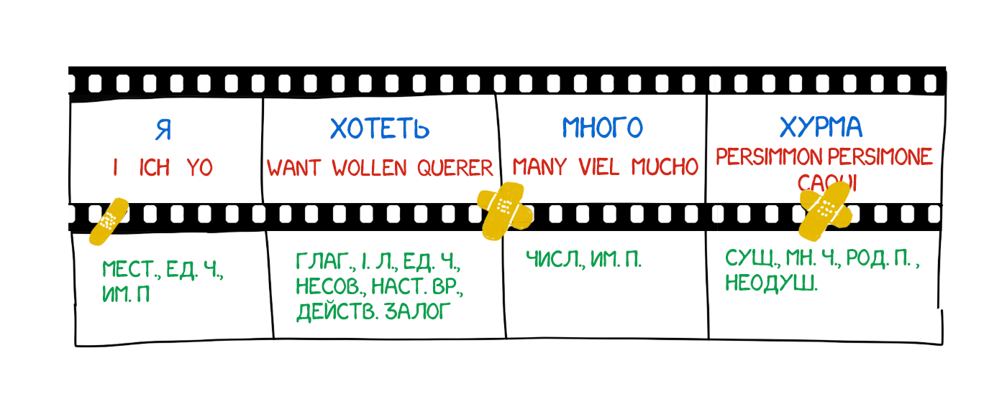

Slide 3
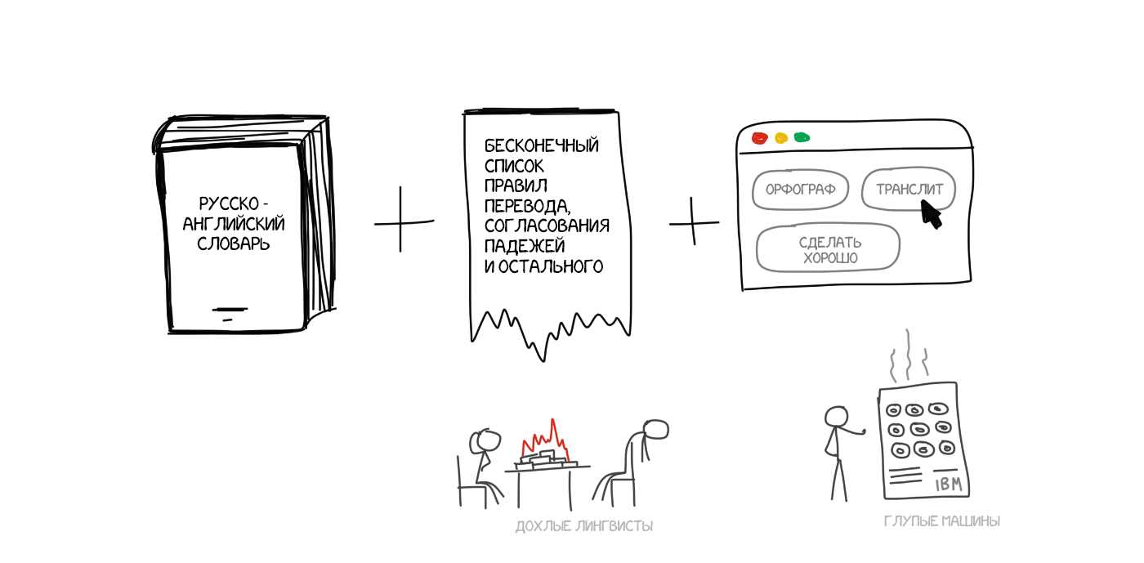
Rule-based Machine Translation (RBMT)

Slide 4
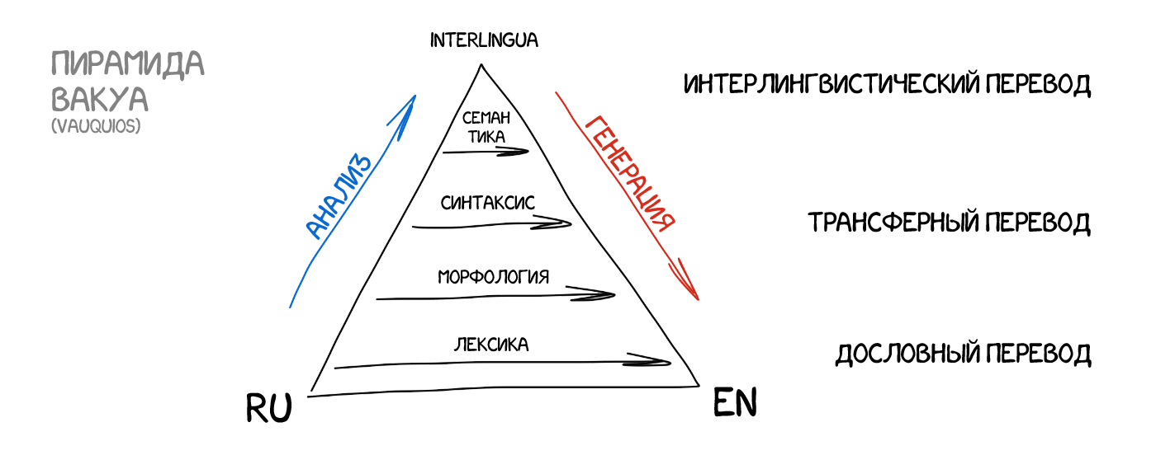

Slide 5
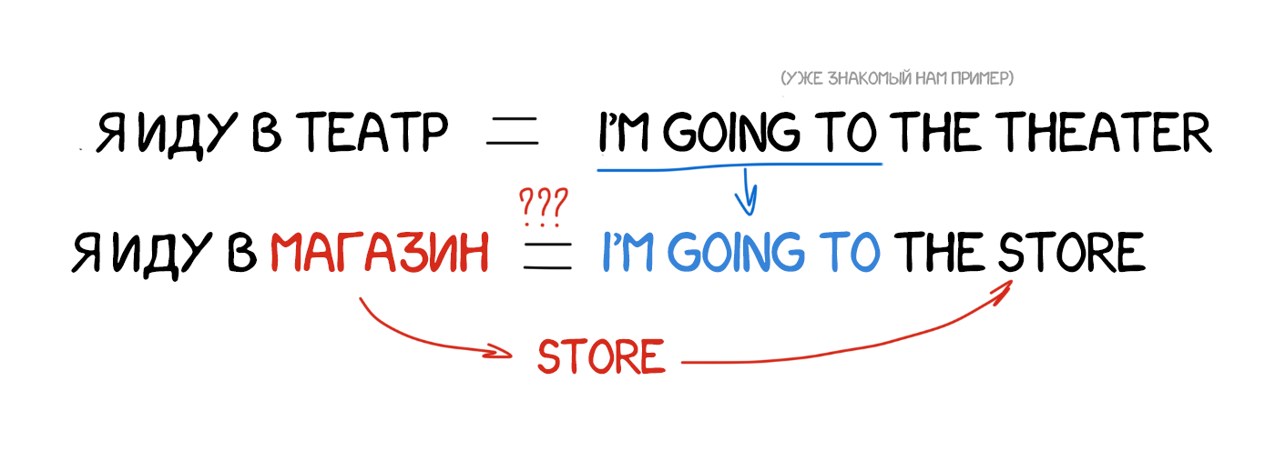
Example-based Machine Translation (EBMT)

Slide 6
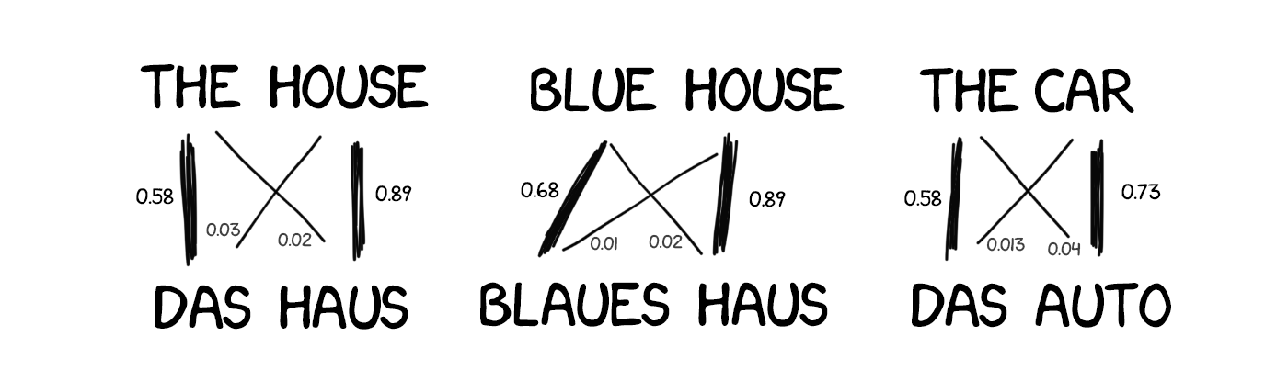
Statistical Machine Translation (SMT)

Slide 7
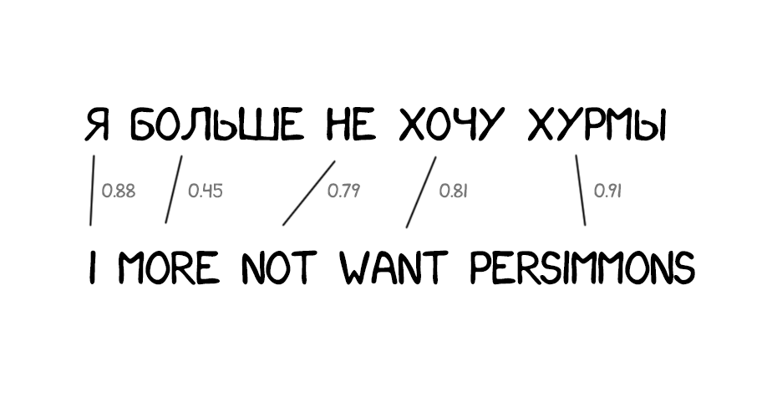
Word-based SMT (Model 1)

Slide 8
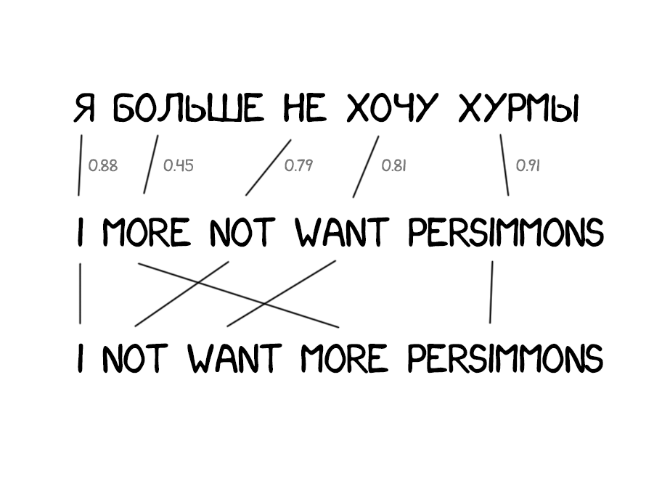
Word-based SMT (Model 2)

Slide 9
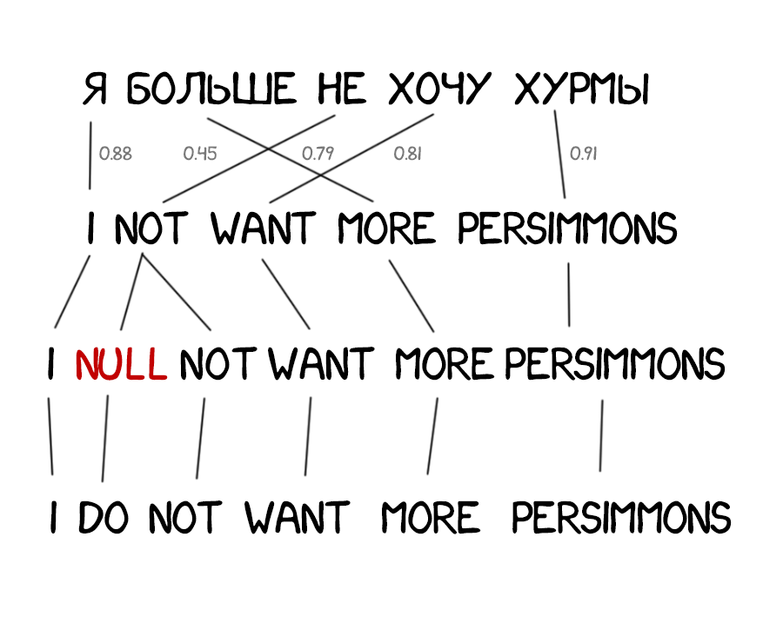
Word-based SMT (Model 3)

Slide 10
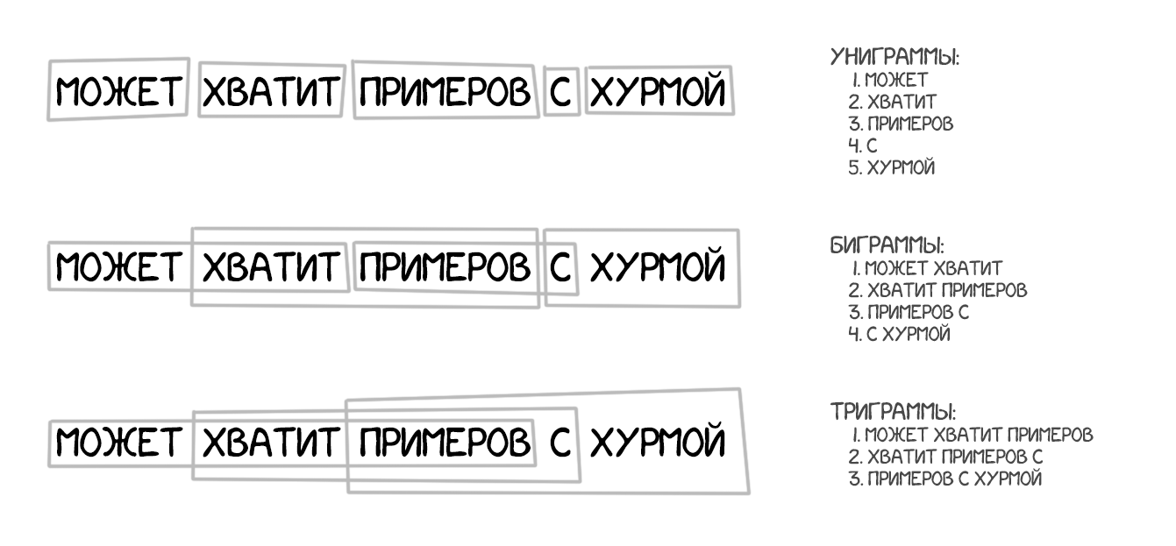
Phrase-based SMT

Slide 11
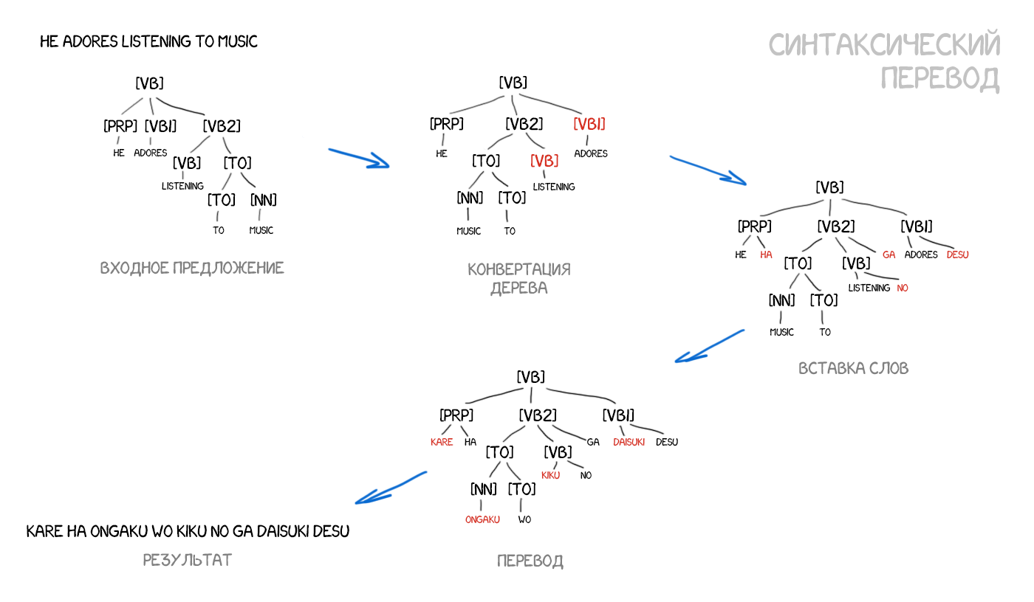

Slide 12
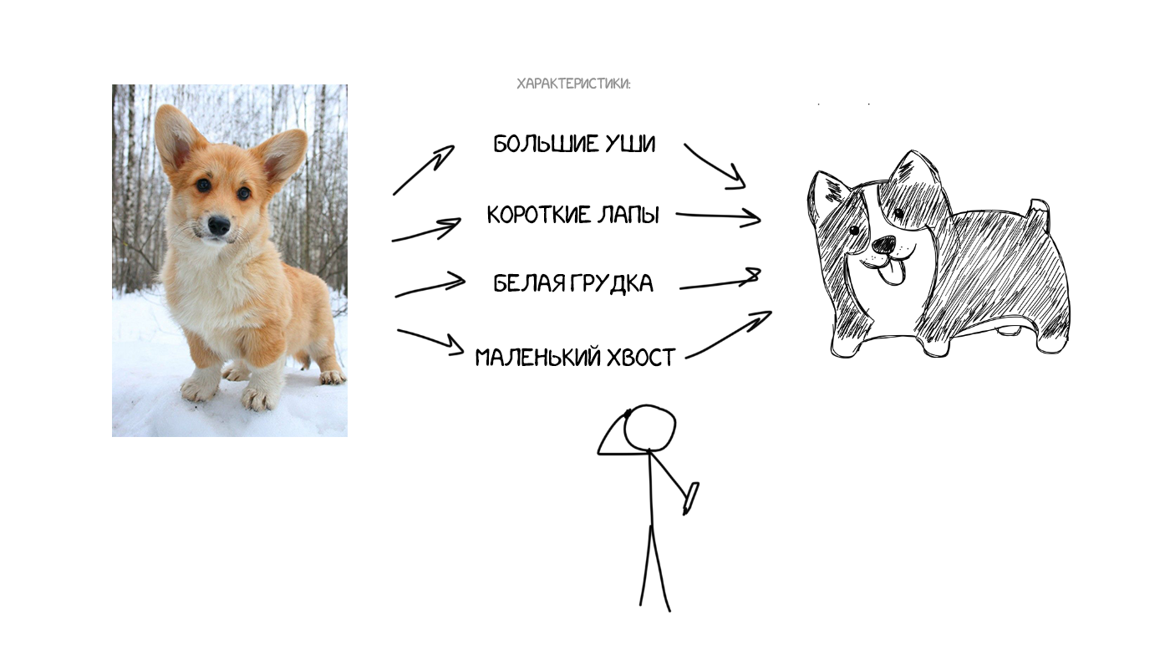
Neural Machine Translation (NMT)

Slide 13
